Slide 1

CLC 12: Capstone Project
.
Covitionary: Development of a Covid-19 Vocabulary using Text-Mining
Harjap Gosal

Slide 2
Introduction
We have been facing a challenge of our lifetimes in the form of the Covid19 pandemic since the start of 2020.
The scientists and researchers of the world are working very hard to control the deadly virus and the disease.
It has led to the creation of a large amount of scientific and non-scientific literature covering the different aspects of the pandemic, such as surveillance, prevention, diagnosis, transmission, treatment drugs, and vaccines to name a few.
The automatic means of text-mining and creating standardized resources could help researchers further in dealing with the overwhelming literature.

Slide 3
Objective
To develop a terminological resource for a vocabulary of terms in the COVID domain (Covitionary) by mining the literature of COVID-19 terms.
To automatically acquire the various terms from the text (expected target of more than 10000 terms) and organize these in a vocabulary.
To make Covitionary resource publically available via GitHub, a public code hosting platform, enabling it to be used for potential applications such as classifications, or other associated text-mining works.

Slide 4
Significance
The current project has a direct relevance to my intended field of career i.e. computer-based technological innovations.
It is based on the knowledge, skills and experience that I have gained during my high school years through courses such as science, math, and computer programming, practical experiences in and outside of school, and other school experiences.
I will further use the research perspectives I learned when I contributed to the open-source community by curating new terms for some standard vocabularies.

Slide 5
Methodology
Natural Language Processing (NLP) techniques, especially text-mining pipeline, implemented in the Python programming language will be used.
The software pipeline will automatically process and acquire the different terms in Covid-19 domain from the text.
Covitionary will be made publically available via GitHub, a public code hosting platform.

Slide 6
Implementation (Input Data)
Input Covid-19 Corpus Data
LitCovid is a curated literature hub for tracking up-to-date scientific information about the 2019 novel Coronavirus (1-3) that provides centralized access to more than 120000 (and expanding) related articles (121620 as of 1 May 2021 ).
The input data consisting of titles of these papers from LitCovid (1-3) has been used for garnering the most frequently used terms and building a large terminological resource (Covitionary) in Covid-19 domain.
The source input data could be accessed at https://github.com/HarjapGosal/Covitionary/blob/main/covitionary/data/input/covid-literature-input.csv

Slide 7
Implementation (A Snapshot of Input Data)
Paper Title Early adoption of non-pharmaceutical interventions and COVID-19 mortality. ABO blood groups, COVID-19 infection and mortality. Patient satisfaction scores with telemedicine in the neurosurgical population. An international perspective of out-of-hospital cardiac arrest and cardiopulmonary resuscitation during the COVID-19 pandemic. Acute Fulminant Cerebellitis in Children With COVID-19: A Rare But a Treatable Complication. Eight-month follow-up of olfactory and gustatory dysfunctions in recovered COVID-19 patients. Resveratrol-zinc nanoparticles or pterostilbene-zinc: Potential COVID-19 mono and adjuvant therapy. Objectively measured digital technology use during the COVID-19 pandemic: Impact on depression, anxiety, and suicidal ideation among young adults. Phenoxazine nucleoside derivatives with a multiple activity against RNA and DNA viruses. Mental disorder prevalence among populations impacted by coronavirus pandemics: A multilevel meta-analytic study of COVID-19, MERS & SARS. Screening of potent phytochemical inhibitors against SARS-CoV-2 protease and its two Asian mutants. From the Cochrane Library: Teledermatology for Diagnosing Skin Cancer in Adults. .................................................... ....................................................

Slide 8
Implementation (Software)
Software:
The term extractor tool for Covitionary is implemented in Python language.
The algorithm is based on the “text-mining” technique. The “covitionary_pipeline.py” is the main program which implements the system.
The implemented code for applying this technique performs certain functions that are implemented in terms of several routines or modules available in the program covitionary_helpers.py.

Slide 9
Results
Output:
The outputs are generated for
individual word frequency,
most frequent bigrams i.e 2-word phrase (based on different frequencies),
most frequent trigrams i.e 3-word phrase (based on different frequencies), and
most frequent quadgrams i.e 4-word phrase (based on different frequencies.
The list of output files is available at - https://github.com/HarjapGosal/Covitionary/tree/main/covitionary/data/output, from which the Covitionary is created.

Slide 10
Results (Some Snapshots of Outputs)
Table 1: The top most 10 most frequent individual words with frequency.
Table 2: The top 10 most frequent bigrams i.e 2-word phrases (frequency>500).
Word | Frequency
covid19 | 84018
pandemic | 23119
patients | 16306
sarscov2 | 15637
coronavirus | 12260
disease | 10065
health | 8247
study | 7559
infection | 7104
care | 6416
Bigram
covid-19 pandemic
coronavirus disease
covid-19 patients
sars-cov-2 infection
mental health
covid-19 infection
systematic review
covid-19 outbreak
novel coronavirus
severe covid-19

Slide 11
Results (Some Snapshots of Outputs)
Table 3: The top most 10 most frequent trigrams i.e. 3-word phrases (frequency>200).
Table 4: The top 10 most frequent quad-grams i.e 4.-word phrases (frequency>100).
Trigram
coronavirus disease 2019
critically ill patients
personal protective equipment
intensive care unit
health care workers
New York city
retrospective cohort study
novel coronavirus disease
multisystem inflammatory syndrome
acute kidney injury
Quadgram
severe acute respiratory syndrome
acute respiratory syndrome coronavirus
coronavirus disease 2019 pandemic
acute respiratory distress syndrome
critically ill covid-19 patients
coronavirus disease 2019 patients
severe coronavirus disease 2019
acute respiratory syndrome coronavirus-2
novel coronavirus disease 2019
corona virus disease 2019

Slide 12
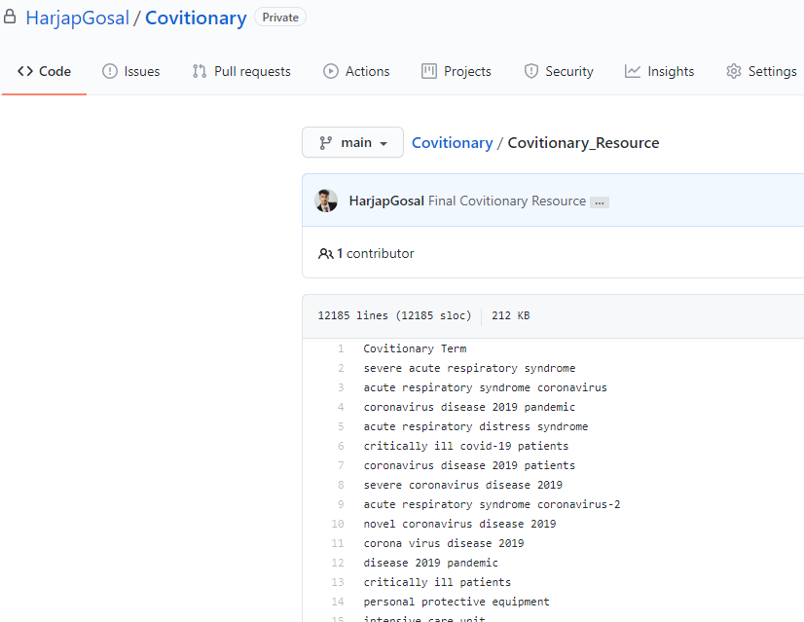
Results (Covitionary Resource)
Covitionary Resource:
From the output files and after analysis of the results, the following dictionary of Covid-19 domain terms is generated that contains 12184 frequent terms (Fig. shows a snapshot of Covitionary resource available at GitHub):
https://github.com/HarjapGosal/Covitionary/blob/main/Covitionary_Resource
Figure: A snapshot of Covitionary resource available
at GitHub.

Slide 13
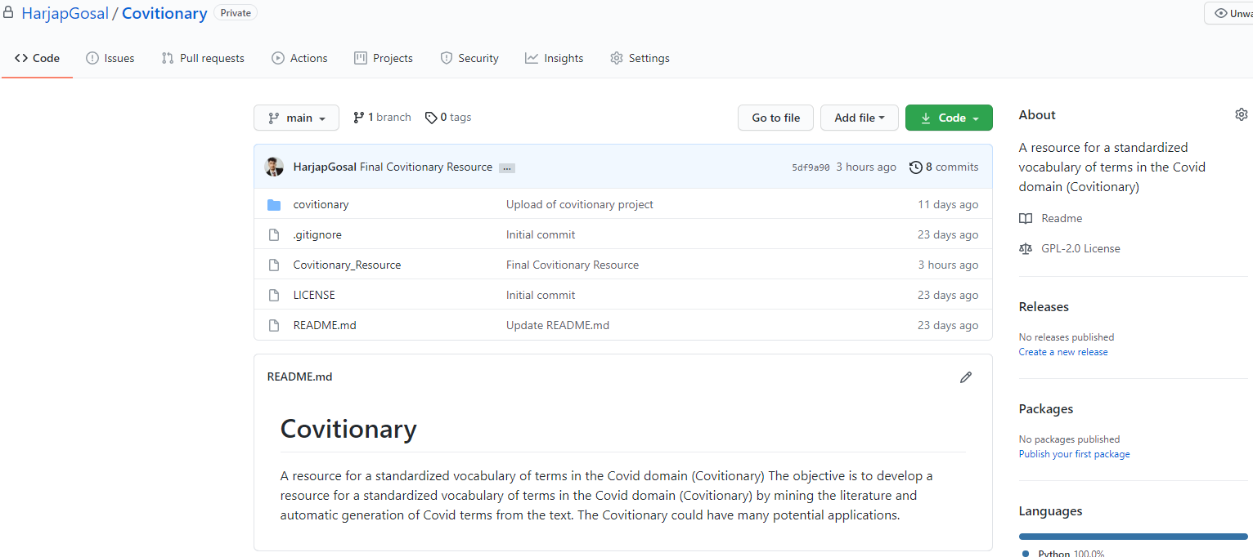
Availability
This resource has been made publically available via GitHub, a public code hosting platform, at
https://github.com/HarjapGosal/Covitionary.

Slide 14
Potential Applications
Covitionary could be used for spell checking, making ontologies (that are standard hierarchical vocabularies in a particular domain).
It could also be used for further classification of terms in pre-defined categories in the Covid19 domain such as Treatment, Diagnosis, Transmission, Prevention, Research and Study, Travel, Forecasting, Mechanism/ Device/Tool etc.
One such example of classification as a proof-of-concept is given in the Table 5 here.
Table 5: Proof-of-concept of classification of terms in pre-defined categories in the Covid19 domain (showing 10 terms for 5 categories from the gathered terms)
Prevention | Treatment | Potential Covid Drugs | Covid Related Travel Terms | Transmission Terms
infection prevention antibody detection biosecurity concern close proximity early detection serological testing antibody response control measures preventive measures surveillance testing | corticosteroid intravenous fluids oral fluids orogastric fluids medication agent experimental agent antimalarial agent antifungal agent antiviral medication interferon alpha | azithromycin favipiravir umifenovir colchicine lopinavir chloroquine ritonavir ilaris hydroxychloroquine remdesivir | travel restrictions air travel covid-19 travel international travel travel medicine travel history returning travelers travel bans travel health travel patterns | aerosol transmission airborne transmission asymptomatic transmission community transmission contact transmission covid-19 transmission cross-species transmission disease transmission droplet transmission dynamic transmission

Slide 15
Conclusion
With every passing day, an overwhelming amount of literature is being generated by the researchers working in the Covid-19 domain.
The terminological resources are the basis of many useful applications in any domain, and Covitionary (a dictionary of most frequent terms in Covid-19 domain) is one such useful terminological resource.
The use of automatic text-mining pipeline here has resulted in 12184 terms in Covid related texts that have a frequency of 7 or more in the text.
This resource has potential applications in many natural language processing tasks in the Covid19 domain as some of these are outlined earlier.

Slide 16
Reference
Chen Q, Allot A, Lu Z. Keep up with the latest coronavirus research. Nature. 2020 Mar;579(7798):193-193.
Chen Q, Allot A, Lu Z. LitCovid: an open database of COVID-19 literature. Nucleic Acids Research. 2021 Jan 8;49(D1):D1534-40.
Wei CH, Allot A, Leaman R, Lu Z. PubTator central: automated concept annotation for biomedical full text articles. Nucleic acids research. 2019 Jul 2;47(W1):W587-93.
Wang LL, Lo K, Chandrasekhar Y, Reas R, Yang J, Eide D, Funk K, Kinney R, Liu Z, Merrill W, Mooney P. Cord-19: The covid-19 open research dataset. ArXiv. 2020 Jul 9.

